Slide 1
1 CHRONICLES

Slide 2
1 CHRONICLES
1 and 2 Chronicles originally one book until 180 BC
LXX called it "The Things Omitted”
Original title: “The Annals (Affairs) of the Days”
The name "Chronicles" comes from Vulgate

Slide 3
1 CHRONICLES
Ezra, traditional author
Book of the
Kings of Judah
Book of the
Kings of Israel

Slide 4
1 CHRONICLES
1 and 2 Samuel
1 Chronicles
=
1 and 2 Kings
=
2 Chronicles

Slide 5
1 CHRONICLES
Three reasons for reiteration:
1) Repetition
2) Different facets
3) Law of Recapitulation

Slide 6
1 CHRONICLES
"In Kings the history of the nation is given from the standpoint of the throne; in Chronicles it is given from the standpoint of the altar. In Kings the palace is the center; in Chronicles the temple is the center. Kings gives us political history of the nation, while Chronicles gives the religious history."
J. Vernon McGee

Slide 7
1 CHRONICLES
"God buries His workmen, and carries on His work."
Charles Wesley

Slide 8
1 CHRONICLES
One of illegitimate birth shall not enter the assembly of the Lord; even to the tenth generation none of his descendants shall enter the assembly of the Lord.
Deuteronomy 23.2

Slide 9
1 CHRONICLES
1. Perez
2. Hezron
3. Ram
4. Amminadab
5. Nahshon
6. Salma (Salmon)
7. Boaz
8. Obed
9. Jesse
10. David
1 Chronicles 2.5-15

Slide 10
1 CHRONICLES
Also it shall be, when he sits on the throne of his kingdom, that he shall write for himself a copy of this law in a book, from the one before the priests, the Levites.
Deuteronomy 17.18

Slide 11
1 CHRONICLES
For whatever is born of God overcomes the world. And this is the victory that has overcome the world — our faith.
1 John 5.4

Slide 12
1 CHRONICLES
Where there is no counsel, the people fall;
But in the multitude of counselors there is safety.
Proverbs 11.14

Slide 13
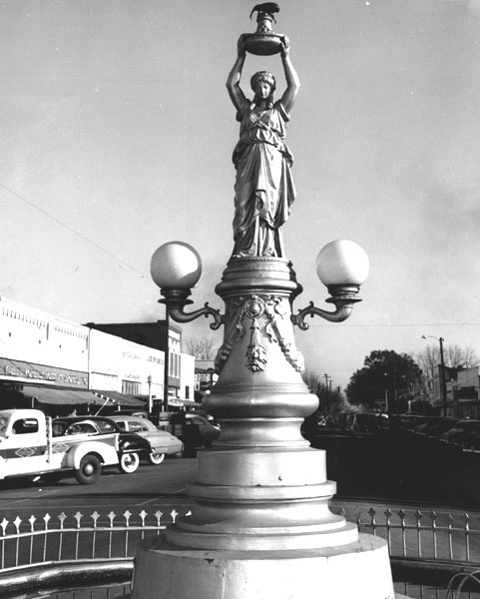
1 CHRONICLES

Slide 14
1 CHRONICLES
³⁸ For I am persuaded that neither death nor life, nor angels nor principalities nor powers, nor things present nor things to come, ³⁹ nor height nor depth, nor any other created thing, shall be able to separate us from the love of God which is in Christ Jesus our Lord.
Romans 8.38-39

Slide 15
1 CHRONICLES
After these things the word of the Lord came to Abram in a vision, saying, “Do not be afraid, Abram. I am your shield, your exceedingly great reward.”
Protection
Provision
Genesis 15.1

Slide 16
1 CHRONICLES
W E L L I N G T O N D E F E A T E D
T H E E N E M Y

